Slide 1

Unit-1 Fundamentals of Digital systems and Logic families
Digital Fundamentals (DF)
GTU # 3130704
Prof. Krunal D. Vyas
Computer Engineering Department
krunal.vyas@darshan.ac.in
9601901005

Slide 2

Outline
Number Systems
Binary, Octal, Decimal, Hexa-decimal, Binary arithmetic operations
Binary Codes
Basic codes, Error detecting and correcting codes
Boolean Algebra
Logic Gates
AND, OR, NOT, NAND, NOR, EX-OR, EX-NOR
Logic Family Terminology
TTL, Schottky TTL, CMOS logic, Tri-state logic
Looping

Slide 3
Number System
Section - 1

Slide 4
Common Number Systems
System | Base | Symbols | Used by Humans? | Used in Computers?
Decimal | 10 | 0, 1, … 9 | Yes | No
Binary | 2 | 0, 1 | No | Yes
Octal | 8 | 0, 1, … 7 | No | No
Hexa- decimal | 16 | 0, 1, … 9, A, B, … F | No | No

Slide 5
Conversion among Bases
Possibilities
Example
Decimal
Octal
Binary
Hexadecimal
25₁₀ = 11001₂ = 31₈ = 19₁₆
Base

Slide 6
Decimal to Binary
Technique
Divide by two, keep track of the remainder
The remainders read from bottom to top give the equivalent binary integer number.
Example - 1
Example - 2
125₁₀ = ?₂
2
125
1
0.6875₁₀ = ?₂
integer
fraction
2
62
0
2
31
1
1.3750
1
0.6875 x 2 =
+
0.3750
2
15
1
0.7500
0
0.3750 x 2 =
+
0.7500
1.5000
1
2
7
1
0.7500 x 2 =
+
0.5000
1.0000
1
2
3
1
0.5000 x 2 =
+
0.0000
2
1
1
0
0.6875₁₀ =
0.1011₂
125₁₀ =
1111101₂

Slide 7
Binary to Decimal
Technique
Multiply each bit by 2^{n}, where n is the “weight” of the bit
The weight is the position of the bit, starting from 0 on the right. Finally, Add the results.
Example - 1
Example - 2
101011₂ = ?₁₀
11.11₂ = ?₁₀
1 0 1 0 1 1
1 1 . 1 1
1 x 2¹
1 x 2⁰
1 x 2⁵
+
+
1 x 2³
0 x 2²
1 x 2⁻¹
1 x 2⁻²
0 x 2⁴
+
+
+
+
1 x 2¹
1 x 2⁰
+
+
2
1
32
8
+
+
0
0.5
0.25
0
+
+
+
+
2
1
+
+
101011₂ =
11.11₂ =
43₁₀
3.75₁₀

Slide 8
Decimal to Octal
Technique
Divide by eight, keep track of the remainder
The remainders read from bottom to top give the equivalent octal integer number.
Example - 1
Example - 2
125₁₀ = ?₈
0.6875₁₀ = ?₈
8
125
5
integer
fraction
8
15
7
+
0.5000
0.6875 x 8 =
5.5000
5
8
1
1
+
0.0000
0.5000 x 8 =
4.0000
4
0
125₁₀ =
175₈
0.6875₁₀ =
0.54₈

Slide 9
Octal to Decimal
Technique
Multiply each digit by 8^{n}, where n is the “weight” of the digit
The weight is the position of the digit, starting from 0 on the right. Finally, Add the results.
Example - 1
Example - 2
724₈ = ?₁₀
43.25₈ = ?₁₀
7 2 4
4 3 . 2 5
4 x 8¹
3 x 8⁰
+
+
2 x 8⁻¹
5 x 8⁻²
7 x 8²
+
2 x 8¹
+
4 x 8⁰
+
32
3
+
+
0.25
0.0781
448
+
16
+
4
+
724₈ =
468₁₀
43.25₈ =
35.3281₁₀

Slide 10
Decimal to Hexa-Decimal
Technique
Divide by sixteen, keep track of the remainder
The remainders read from bottom to top give the equivalent hexadecimal integer number.
Example - 1
Example - 2
1234₁₀ = ?₁₆
0.03125₁₀ = ?₁₆
16
1234
2
integer
fraction
16
77
13=D
+
0.5000
0.03125 x 16 =
0.5000
0
16
4
4
+
0.0000
0.5000 x 16 =
8.0000
8
0
1234₁₀ =
4D2₁₆
0.03125₁₀ =
0.08₁₆

Slide 11
Hexa-Decimal to Decimal
Technique
Multiply each digit by 16^{n}, where n is the “weight” of the digit
The weight is the position of the digit, starting from 0 on the right. Finally, Add the results.
Example - 1
Example - 2
ABC₁₆ = ?₁₀
43.25₁₆ = ?₁₀
A B C
4 3 . 2 5
A x 16²
+
B x 16¹
+
C x 16⁰
4 x 16¹
3 x 16⁰
+
+
2 x 16⁻¹
5 x 16⁻²
+
10 x 16²
+
11 x 16¹
+
12 x 16⁰
64
3
+
+
0.125
0.0195
+
2560
+
176
+
12
ABC₁₆ =
2748₁₀
43.25₁₆ =
67.1445₁₀

Slide 12
Octal to Binary
Technique
Convert each octal digit to a 3-bit equivalent binary representation
Example
Octal | Binary
0 | 000
1 | 001
2 | 010
3 | 011
4 | 100
5 | 101
6 | 110
7 | 111
705₈ = ?₂
7 0 5
111
000
101
705₈ =
111000101₂

Slide 13
Binary to Octal
Technique
From given fractional point, group bits in threes to right and group bits in threes to left
If, left with less than 3 bits at the end then stuff 0s to make it group of three
Convert to octal digits
Example
1011010.111₂ = ?₈
001
011
010
.
111
1
3
2
7
1011010111₂ =
132.7₈

Slide 14
Hexa-Decimal to Binary
Technique
Convert each hexadecimal digit to a 4-bit equivalent binary representation
Example
Hexa-Decimal | Binary | Hexa-Decimal | Binary
0 | 0000 | 8 | 1000
1 | 0001 | 9 | 1001
2 | 0010 | A | 1010
3 | 0011 | B | 1011
4 | 0100 | C | 1100
5 | 0101 | D | 1101
6 | 0110 | E | 1110
7 | 0111 | F | 1111
10AF₁₆ = ?₂
1 0 A F
0001
0000
1010
1111
10AF₁₆ =
1000010101111₂

Slide 15
Binary to Hexa-Decimal
Technique
From given fractional point, group bits in fours to right and group bits in fours to left
If, left with less than 4 bits at the end then stuff 0s to make it group of four
Convert to hexadecimal digits
Example
101101.0111₂ = ?₁₆
0010
1101
.
0111
2
D
7
1011010111₂ =
2D.7₁₆

Slide 16
Octal to Hexa-Decimal
Technique
Convert Octal to Binary
From given fractional point, group bits in fours to right and group bits in fours to left
Convert Binary to Hexa-Decimal
Example
1076₈ = ?₁₆
1 0 7 6
001
000
111
110
0010
0011
1110
2
3
E
1076₈ =
23E₁₆

Slide 17
Hexa-Decimal to Octal
Technique
Convert Hexa-Decimal to Binary
From given fractional point, group bits in threes to right and group bits in threes to left
Convert Binary to Octal
Example
1F0C₁₆ = ?₈
1 F 0 C
0001
1111
0000
1100
000
001
111
100
001
100
0
1
7
4
1
4
1F0C₁₆ =
17414₈

Slide 18
Binary Addition & Subtraction
Rules for binary addition
Rules for binary subtraction
0 + 0 = 0
0 – 0 = 0
0 + 1 = 1
1 – 1 = 0
1 + 0 = 1
1 – 0 = 1
1 + 1 = 10 i.e. 0 with a carry of 1
0 – 1 = 1, with a borrow 1
1
1
1
1
1
1
0
1
0
1
1
1
1
0
1
0
1
0
0
1
1
1
1
0
1
.
1
0
1
.
0
+
0
1
1
1
.
0
1
1
-
0
1
1
1
.
1
1
1
1
0
1
0
1
.
0
0
0
0
0
1
0
.
0
1
1

Slide 19
Binary Multiplication & Division
Multiplication
Division
1 0 1 1 1
110
1 0 1 1 0 1
0
1
1
1
.
1
x
0 0 0
1 0 0 1 1
1 0 1
1
1
0
1
1
1
1 1 0
1 0 1
0
1
0
1
1
1
1 1 0
0
0
0
0
0
1 0 0
1
0
0
0
0
0
1 1 0
1 1
0
1
0
1
1
1
1 1 0
1
1
0
1
1
0
1
0
1
0 0 0

Slide 20
Signed Binary Numbers
Two ways of representing signed numbers:
1) Sign-magnitude form, 2) Complement form.
Most of computers use complement form for negative number notation.
1’s complement and 2’s complement are two different methods in this type.

Slide 21
1’s Complement
1’s complement of a binary number is obtained by subtracting each digit of that binary number from 1.
Example
1
1
1
1
1
1
1
.
1
1
-
1
1
0
1
-
1
0
1
.
0
1
0
0
1
0
0
1
0
.
1
0
(1’s complement of 1101)
(1’s complement of 101.01)
Shortcut: Invert the numbers from 0 to 1 and 1 to 0

Slide 22
2’s Complement
2’s complement of a binary number is obtained by adding 1 to its 1’s complement.
Example
1
1
1
1
1
1
1
.
1
1
-
1
1
0
0
-
1
0
1
.
0
1
0
0
1
1
0
1
0
.
1
0
+
1
+
1
0
1
0
0
0
1
0
.
1
1
(2’s complement of 1100)
(2’s complement of 101.01)
Shortcut: Starting from right side, all bits are same till first 1 occurs and then invert rest of the bits

Slide 23
Representation of negative number in 2’s complement form
Express -65.5 in 12 bit 2’s complement form.
2
65
1
1.0
0.5 x 2 =
2
32
0
So, result in 12-bit binary is as follows:
2
16
0
65.5₁₀ =
01000001.1000₂
2
8
0
For negative number, we have to convert this into 2’s complement form
2
4
0
2
2
0
-65.5₁₀ =
10111110.1000₂
2
1
1
0

Slide 24
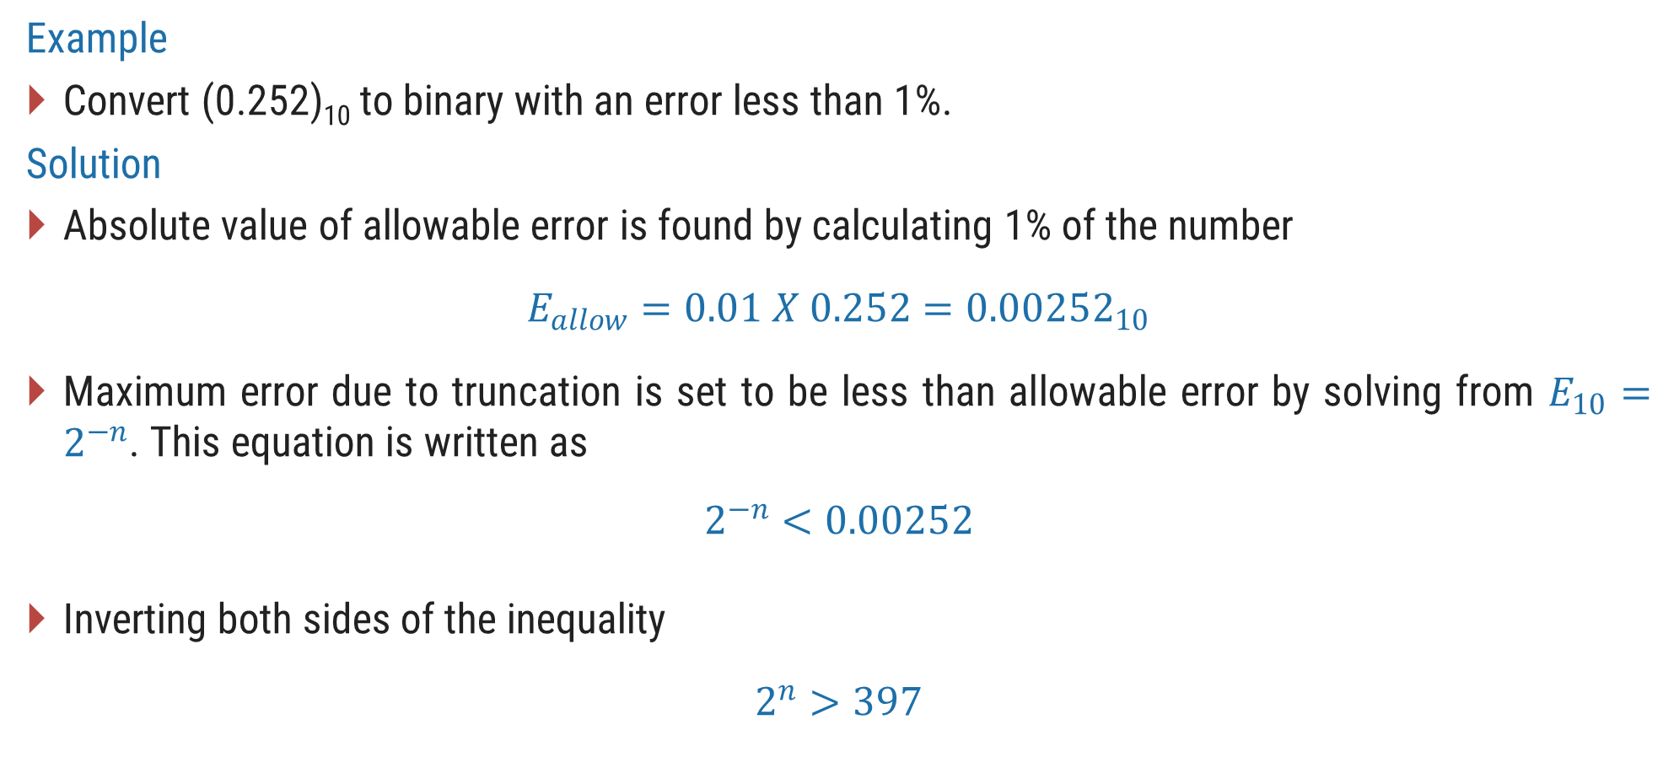
Accuracy in Binary Number Conversion
Example
Convert (0.252)₁₀ to binary with an error less than 1%.
Solution
Absolute value of allowable error is found by calculating 1% of the number
$$E_{allow}=0.01 X 0.252={0.00252}_{10}$$
Maximum error due to truncation is set to be less than allowable error by solving from $E_{10}=2^{−n}$. This equation is written as
$$2^{−n}<0.00252$$
Inverting both sides of the inequality
$$2^{n}>397$$

Slide 25
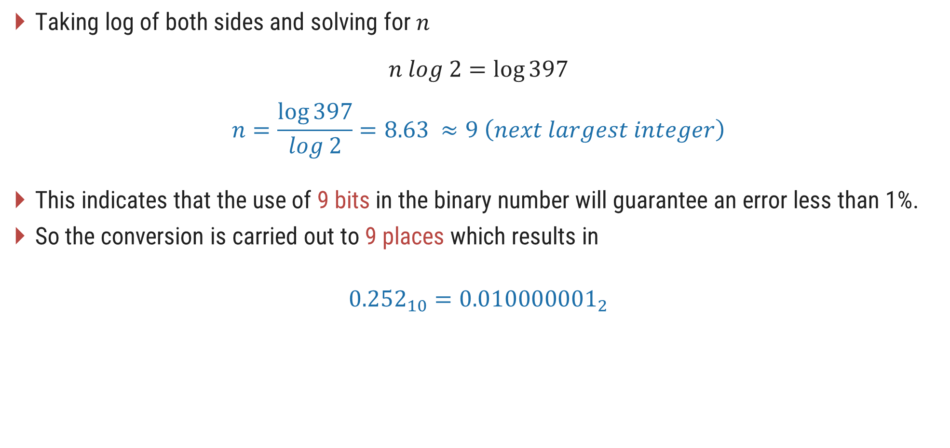
Accuracy in Binary Number Conversion
Taking log of both sides and solving for $n$
$$n log 2=\log{397}$$
$$n=\frac{\log{397}}{log 2}=8.63 ≈9 \left(next largest integer\right)$$
This indicates that the use of 9 bits in the binary number will guarantee an error less than 1%.
So the conversion is carried out to 9 places which results in
$${0.252}_{10}={0.010000001}_{2}$$

Slide 26
9’s Complement
9’s complement of a decimal number is obtained by subtracting each digit of that decimal number from 9.
Example
9
9
9
9
9
9
9
.
9
9
-
3
4
6
5
-
7
8
2
.
5
4
6
5
3
4
2
1
7
.
4
5
(9’s complement of 3465)
(9’s complement of 782.54)

Slide 27
10’s Complement
10’s complement of a decimal number is obtained by adding 1 to its 9’s complement.
Example
9
9
9
9
9
9
9
.
9
9
-
3
4
6
5
-
7
8
2
.
5
4
6
5
3
4
2
1
7
.
4
5
+
1
+
1
6
5
3
5
2
1
7
.
4
6
(10’s complement of 3465)
(10’s complement of 782.54)

Slide 28
Subtraction using 9’s complement & 10’s complement
Using 9’s complement
Obtain 9’s complement of subtrahend
Add the result to minuend and call it intermediate result
If carry is generated then answer is positive and add the carry to Least Significant Digit (LSD)
If there is no carry then answer is negative and take 9’s complement of intermediate result and place negative sign to the result.
Using 10’s complement
Obtain 10’s complement of subtrahend
Add the result to minuend
If carry is generated then answer is positive, ignore carry and result itself is answer
If there is no carry then answer is negative and take 10’s complement of intermediate result and place negative sign to the result.

Slide 29
Subtraction using 9’s complement (Examples)
Example - 1
745.81 – 436.62
7
4
5
.
8
1
7
4
5
.
8
1
-
4
3
6
.
6
2
9’s complement
+
5
6
3
.
3
7
3
0
9
.
1
9
1
3
0
9
.
1
8
+
1
3
0
9
.
1
9

Slide 30
Subtraction using 9’s complement (Examples)
Example - 2
436.62 - 745.81
4
3
6
.
6
2
4
3
6
.
6
2
-
7
4
5
.
8
1
9’s complement
+
2
5
4
.
1
8
-
3
0
9
.
1
9
6
9
0
.
8
0
9’s complement
-
3
0
9
.
1
9
As carry is not generated, so take 9’s complement of the intermediate result and add ‘ – ‘ sign to the result

Slide 31
Subtraction using 10’s complement (Examples)
Example - 1
745.81 – 436.62
7
4
5
.
8
1
7
4
5
.
8
1
-
4
3
6
.
6
2
10’s complement
+
5
6
3
.
3
8
3
0
9
.
1
9
1
3
0
9
.
1
9
Ignore the carry

Slide 32
Subtraction using 10’s complement (Examples)
Example - 2
436.62 - 745.81
4
3
6
.
6
2
4
3
6
.
6
2
-
7
4
5
.
8
1
10’s complement
+
2
5
4
.
1
9
-
3
0
9
.
1
9
6
9
0
.
8
1
10’s complement
-
3
0
9
.
1
9
As carry is not generated, so take 10’s complement of the intermediate result and add ‘ – ‘ sign to the result

Slide 33
Subtraction using 1’s complement & 2’s complement
Using 1’s complement
Obtain 1’s complement of subtrahend
Add the result to minuend and call it intermediate result
If carry is generated then answer is positive and add the carry to Least Significant Digit (LSD)
If there is no carry then answer is negative and take 1’s complement of intermediate result and place negative sign to the result.
Using 2’s complement
Obtain 2’s complement of subtrahend
Add the result to minuend
If carry is generated then answer is positive, ignore carry and result itself is answer
If there is no carry then answer is negative and take 2’s complement of intermediate result and place negative sign to the result.

Slide 34
Subtraction using 1’s complement (Examples)
Example - 1
68.75 – 27.50
6
8
.
7
5
1
0
0
0
0
0
0
1
.
1
1
0
0
1’s complement
1
0
0
0
0
-
2
7
.
5
0
+
1
1
1
.
0
1
1
1
4
1
.
2
5
0
1
0
1
0
1
+
1
0
0
.
0
0
1
1
+
1
0
0
1
1
0
0
1
0
.
0
1
0
0

Slide 35
Subtraction using 1’s complement (Examples)
Example - 2
43.25 - 89.75
4
3
.
2
5
0
0
1
1
1
0
1
0
.
0
1
0
0
1’s complement
0
0
0
1
0
-
8
9
.
7
5
+
1
1
1
.
0
0
1
1
4
6
.
5
0
1
0
1
0
0
1
-
1
0
.
0
1
1
1
1’s complement
0
1
0
1
1
0
0
1
.
1
0
0
0
As carry is not generated, so take 1’s complement of the intermediate result and add ‘ – ‘ sign to the result

Slide 36
Subtraction using 2’s complement (Examples)
Example - 1
68.75 – 27.50
6
8
.
7
5
1
0
0
0
0
0
0
1
.
1
1
0
0
2’s complement
1
0
0
0
0
-
2
7
.
5
0
+
1
1
1
.
1
0
0
0
4
1
.
2
5
1
0
1
0
1
0
1
+
0
0
.
0
1
0
0
Ignore Carry bit
0
1
0
1
0
1
0
0
.
0
1
0
0

Slide 37
Subtraction using 2’s complement (Examples)
Example - 2
43.25 - 89.75
4
3
.
2
5
0
0
1
1
1
0
1
0
.
0
1
0
0
2’s complement
0
0
0
1
0
-
8
9
.
7
5
+
1
1
1
.
0
1
0
0
4
6
.
5
0
1
0
1
0
0
1
-
1
0
.
1
0
0
0
2’s complement
0
1
0
1
1
0
0
1
.
1
0
0
0
As carry is not generated, so take 2’s complement of the intermediate result and add ‘ – ‘ sign to the result

Slide 38
Binary Codes
Section - 2

Slide 39
8421 BCD Code (Natural BCD Code)
Each decimal digit, 0 through 9, is coded by 4-bit binary number
8, 4, 2 and 1 weights are attached to each bit
BCD code is weighted code
1010, 1011, 1100, 1101, 1110 and 1111 are illegal codes
Less efficient than pure binary
Arithmetic operations are more complex than in pure binary
Example
Decimal
1 4
BCD
0001
0100
Binary
1110

Slide 40
Binary Codes
Decimal | Binary | BCD
0 | 0 | 0000
1 | 1 | 0001
2 | 10 | 0010
3 | 11 | 0011
4 | 100 | 0100
5 | 101 | 0101
6 | 110 | 0110
7 | 111 | 0111
Decimal | Binary | BCD
8 | 1000 | 1000
9 | 1001 | 1001
10 | 1010 | 0001 0000
11 | 1011 | 0001 0001
12 | 1100 | 0001 0010
13 | 1101 | 0001 0011
14 | 1110 | 0001 0100
15 | 1111 | 0001 0101

Slide 41
BCD Addition
Example - 1
1
1
1
2
5
0
0
1
0
0
1
0
1
+
1
3
+
0
0
0
1
0
0
1
1
3
8
0
0
1
1
1
0
0
0
No carry, no illegal code. So, this is the correct sum.
Rule: If there is an illegal code or carry is generated as a result of addition, then add 0110 to particular that 4 bits of result.

Slide 42
BCD Addition
Example - 2
1
1
1
1
679.6
0110
0111
1001
.0110
+
536.8
+
0101
0011
0110
.1000
1216.4
1011
1010
1111
.1110
All are illegal codes
+0110
+0110
+0110
+.0110
Add 0110 to each
10001
10000
10101
1.0100
Propagate carry
+
1
+
1
+
1
+
1
0001
0010
0001
0110
.0100
Corrected sum

Slide 43
BCD Subtraction
Example - 1
3
8
0
0
1
1
1
0
0
0
-
1
5
-
0
0
0
1
0
1
0
1
2
3
0
0
1
0
0
0
1
1
No borrow. So, this is the correct difference.
Rule: If one 4-bit group needs to take borrow from neighbor, then subtract 0110 from the group which is receiving borrow.

Slide 44
BCD Subtraction
Example - 2
206.7
0010
0000
0110
.0111
-
147.8
-
0001
0100
0111
.1000
58.9
0000
1011
1110
.1111
Borrows are present
-0110
-0110
-.0110
Subtract 0110
0101
1000
.1001
Corrected difference

Slide 45
Excess Three (XS-3) Code
Excess Three Code = 8421 BCD + 0011(3)
XS-3 code is non-weighted BCD code
Also known as self complementing code
0000, 0001, 0010, 1101, 1110 and 1111 are illegal codes
Example
Decimal
1 4
BCD
0001
0100
XS-3
0100
0111

Slide 46
XS-3 Addition
Example
247.6
0101
0111
1010
.1001
+
359.4
+
0110
1000
1100
.0111
Rule: Add 0011 to group which generated carry and Subtract 0011 to group which do not generated carry
607.0
1011
1111
10110
1.0000
Carry generated
+
1
+
1
Propagate carry
1011
10000
0111
.0000
+
1
1100
0000
0111
.0000
- 0011
+0011
+0011
+.0011
1001
0011
1010
.0011
Corrected Sum in XS-3

Slide 47
XS-3 Subtraction
Example
57.6
1000
1010
.1001
Rule: Subtract 0011 to group which generated borrow and Add 0011 to group which do not generated borrow
-
27.8
-
0101
1010
.1011
29.8
0010
1111
.1110
+0011
-0011
-.0011
0101
1100
.1011

Slide 48
Gray Code
Only one bit changes between each pair of successive code words (Unit distance code).
Gray code is a reflected code.
Gray codes are designed recursively using following rules:
1-bit Gray code has two code words, 0 and 1.
The first 2^{n} code words of an (n+1)-bit Gray code equal the code words of n-bit gray code, written in order with a leading 0 appended.
The last 2^{n} code words of an (n+1)-bit Gray code equal the code words of n-bit gray code, but written in reverse order with a leading 1 appended.

Slide 49
Gray Code |  |  |  | Decimal | 4-bit Binary
1-bit | 2-bit | 3-bit | 4-bit
0 | 0 0 | 0 0 0 | 0 0 0 0 | 0 | 0000
1 | 0 1 | 0 0 1 | 0 0 0 1 | 1 | 0001
 | 1 1 | 0 1 1 | 0 0 1 1 | 2 | 0010
 | 1 0 | 0 1 0 | 0 0 1 0 | 3 | 0011
 |  | 1 1 0 | 0 1 1 0 | 4 | 0100
 |  | 1 1 1 | 0 1 1 1 | 5 | 0101
 |  | 1 0 1 | 0 1 0 1 | 6 | 0110
 |  | 1 0 0 | 0 1 0 0 | 7 | 0111
 |  |  | 1 1 0 0 | 8 | 1000
 |  |  | 1 1 0 1 | 9 | 1001
 |  |  | 1 1 1 1 | 10 | 1010
 |  |  | 1 1 1 0 | 11 | 1011
 |  |  | 1 0 1 0 | 12 | 1100
 |  |  | 1 0 1 1 | 13 | 1101
 |  |  | 1 0 0 1 | 14 | 1110
 |  |  | 1 0 0 0 | 15 | 1111

Slide 50



Binary to Gray and Gray to Binary Conversion
Conversion of n-bit Binary number (B) to Gray Code (G) is as follows:
Example: Convert (1001)₂ to Gray Code.
$$G_{n}=B_{n}$$ | $$G_{n−1}=B_{n}⨁{ B}_{n−1}$$ | $$G_{n−2}=B_{n−1}⨁{ B}_{n−2}…$$ | $$G_{1}=B_{2}⨁{ B}_{1}$$
Binary
1
$$⨁$$
0
$$⨁$$
0
$$⨁$$
1
Gray
1
1
0
1

Slide 51



Gray to Binary Conversion
Conversion of n-bit Gray Code (G) to Binary Number (B) is as follows:
Example: Convert Gray code 1101 to Binary.
$$B_{n}=G_{n}$$ | $$B_{n−1}=B_{n}⨁{ G}_{n−1}$$ | $$B_{n−2}=B_{n−1}⨁{ G}_{n−2}…$$ | $$B_{1}=B_{2}⨁{ G}_{1}$$
Gray
1
1
0
1
$$⨁$$
$$⨁$$
$$⨁$$
Binary
1
0
0
1

Slide 52
Error-Detecting Codes
Noise can alter or distort the data in transmission.
The 1s may get changed to 0s and 0s to 1s.
Because digital systems must be accurate to the digit, errors can pose a serious problem.
Single bit error should be detect & correct by different schemes.
Parity, Check Sums and Block Parity are few examples of error detecting code.

Slide 53
Parity
Parity bit is the simplest technique.
There are two types of parity – Odd parity and Even parity.
For odd parity, the parity is set to a 0 or a 1 at the transmitter such that the total number of 1 bits in the word including the parity bit is an odd number.
For even parity, the parity is set to a 0 or a 1 at the transmitter such that the total number of 1 bits in the word including the parity bit is an even number.
For example, 0110 binary number has “1” as Odd parity and “0” as Even parity.
Detect a single-bit error but can not detect two or more errors within the same word.
In any practical system, there is always a finite probability of the occurrence of single error.
E.g. In an even-parity scheme, code 10111001 is erroneous because number of 1s is odd(5), while code 11110110 is error free because number of 1s is even(6).

Slide 54
Check Sums
Simple parity can not detect two errors within the same word.
Added to the sum of the previously transmitted words
At the transmission, the check sum up to that time is sent to the receiver.
The receiver can check its sum with the transmitted sum.
If the two sums are the same, then no errors were detected at the receiver end.
If there is an error, the receiving location can ask for retransmission of the entire data.
This type of transmission is used in teleprocessing system.

Slide 55
Block Parity
01011011
10010101
01101110
11010011
10001101
01110111
0
1
0
0
1
1
0
01011011
10010101
01100110
11010011
10001101
01110111
0
1
0
0
1
1
0
01011011
10010101
01101110
10000011
10001101
01110111
0
1
0
0
1
1
0
Parity Row
01110110
01110110
01110110
Parity Column

Slide 56
Error Correcting Code
7-bit Hamming Code is widely used error correcting code, containing 4 bits of data and 3 bits of even parity.
Pattern: P₁ P₂ D₃ P₄ D₅ D₆ D₇
Group - 1: P₁D₃D₅D₇
Group - 2: P₂D₃D₆D₇
Group - 3: P₄D₅D₆D₇
Example: Data = 1101
P₁ P₂ D₃ P₄ D₅ D₆ D₇ = P₁ P₂ 1 P₄ 1 0 1
P₁ D₃ D₅ D₇ = 1 1 1 1
P₂ D₃ D₆ D₇ = 0 1 0 1
P₄ D₅ D₆ D₇ = 0 1 0 1
7-bit Hamming Code is 1 0 1 0 1 0 1
How to detect error?
Example: Received data = 1001001
P₁ P₂ D₃ P₄ D₅ D₆ D₇ = 1 0 0 1 0 0 1
P₁ D₃ D₅ D₇ = 1 0 0 1 (No Error)
P₂ D₃ D₆ D₇ = 0 0 0 1 (Error)
P₄ D₅ D₆ D₇ = 1 0 0 1 (No Error)
The error word is 0 1 0 = 2₁₀.
Complement the 2nd bit (from left).
Correct code is 1 1 0 1 0 0 1

Slide 57
Boolean Algebra
Section - 3

Slide 58
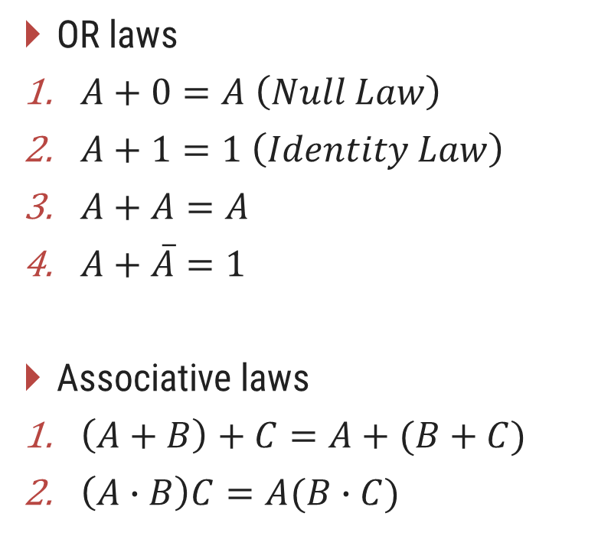
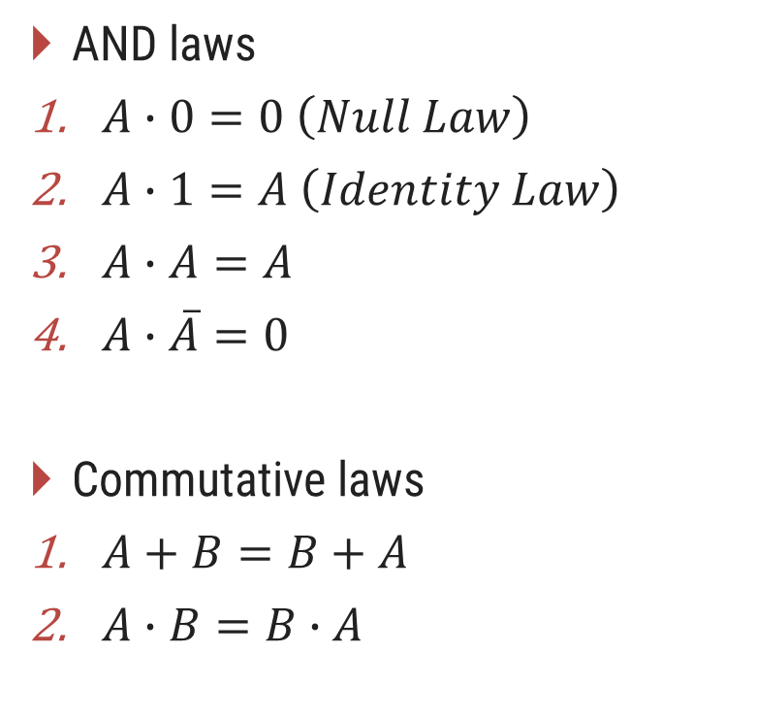
Boolean Algebra Laws
AND laws
$A∙0=0 \left(Null Law\right)$
$A∙1=A \left(Identity Law\right)$
$A∙A=A$
$A∙\overline{A}=0$
Commutative laws
$A+B=B+A$
$A∙B=B∙A$
OR laws
$A+0=A \left(Null Law\right)$
$A+1=1 \left(Identity Law\right)$
$A+A=A$
$A+\overline{A}=1$
Associative laws
$\left(A+B\right)+C=A+(B+C)$
$\left(A∙B\right)C=A(B∙C)$

Slide 59
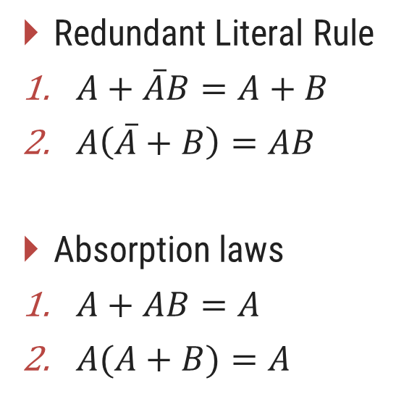
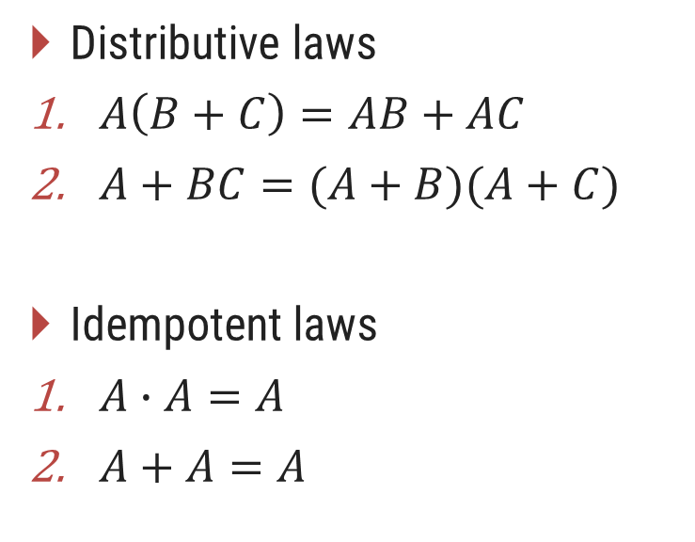
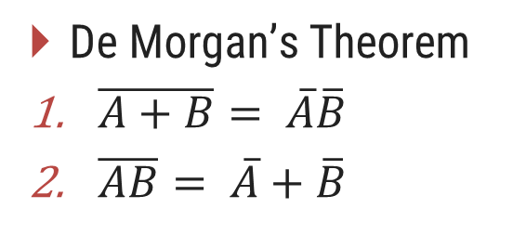
Boolean Algebra Laws
Distributive laws
$A\left(B+C\right)=AB+AC$
$A+BC=(A+B)(A+C)$
Idempotent laws
$A∙A=A$
$A+A=A$
Redundant Literal Rule
$A+\overline{A}B=A+B$
$A\left(\overline{A}+B\right)=AB$
Absorption laws
$A+AB=A$
$A(A+B)=A$
De Morgan’s Theorem
$\overline{A+B}= \overline{A}\overline{B}$
$\overline{AB}= \overline{A}+\overline{B}$
Break the line change the sign

Slide 60
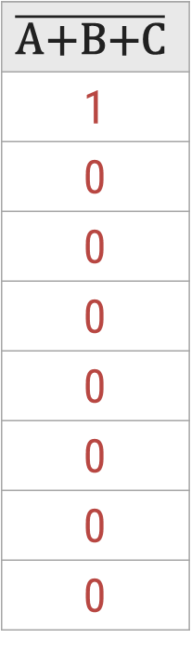
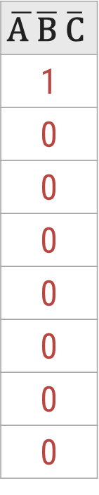
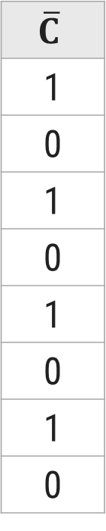
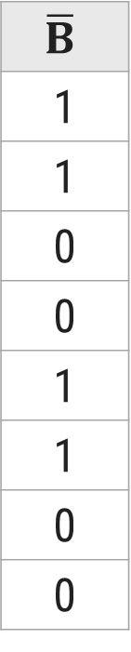
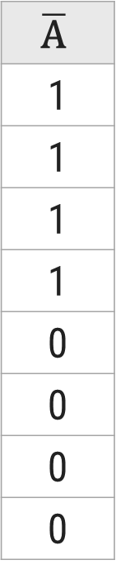
Proof of $\overline{A+B+C}=\overline{A} \overline{B} \overline{C}$
L.H.S.
R.H.S.
A
0
0
0
0
1
1
1
1
B
0
0
1
1
0
0
1
1
C
0
1
0
1
0
1
0
1
A+B+C
0
1
1
1
1
1
1
1
$$\overline{\text{A}\text{+}\text{B}\text{+}\text{C}}$$
1
0
0
0
0
0
0
0
$$\overline{\text{A}}$$
1
1
1
1
0
0
0
0
$$\overline{B}$$
1
1
0
0
1
1
0
0
$$\overline{C}$$
1
0
1
0
1
0
1
0
$$\overline{\text{A} }\overline{\text{B}} \overline{\text{C}}$$
1
0
0
0
0
0
0
0
From truth table, it is clearly visible that L.H.S. = R.H.S. Hence, the complement of a sum of variables is equal to the product of their individual complements.

Slide 61
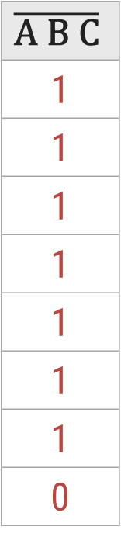
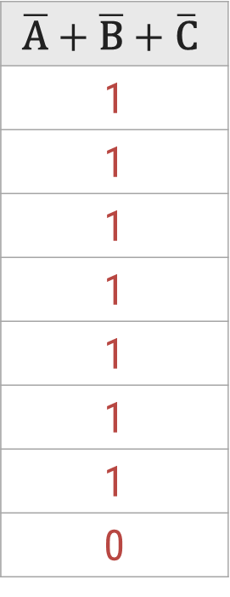
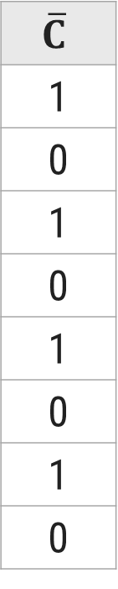
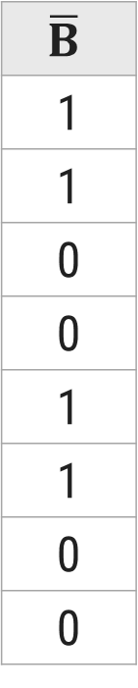
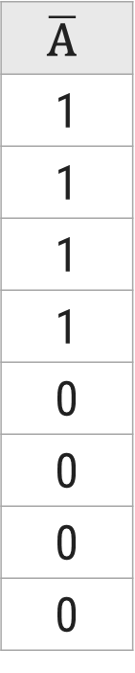
Proof of $\overline{ABC}=\overline{A}+\overline{B}+ \overline{C}$
L.H.S.
R.H.S.
A
0
0
0
0
1
1
1
1
B
0
0
1
1
0
0
1
1
C
0
1
0
1
0
1
0
1
A B C
0
0
0
0
0
0
0
1
$$\overline{\text{A} \text{B} \text{C}}$$
1
1
1
1
1
1
1
0
$$\overline{\text{A}}$$
1
1
1
1
0
0
0
0
$$\overline{B}$$
1
1
0
0
1
1
0
0
$$\overline{C}$$
1
0
1
0
1
0
1
0
$$\overline{\text{A}}+\overline{\text{B}}+\overline{\text{C}}$$
1
1
1
1
1
1
1
0
From truth table, it is clearly visible that L.H.S. = R.H.S. Hence, the complement of a product of variables is equal to the sum of their individual complements.

Slide 62






Reducing Boolean Expression (Example – 1)
Reduce the expression $f=A+B[AC+\left(B+\overline{C}\right)D]$
$$f=A+B[AC+\left(B+\overline{C}\right)D]$$
$$f=A+B[AC+BD+\overline{C}D]$$
(Distributive law)
$$f=A+BAC+BBD+B\overline{C}D$$
(Distributive law)
$$f=A+ABC+BD+B\overline{C}D$$
(A.A = A)
$$f=A(1+BC)+BD(1+\overline{C})$$
$$f=A+BD$$
(1 + A = 1)

Slide 63







Reducing Boolean Expression (Example – 2)
Reduce the expression $f=A[B+\overline{C}(\overline{AB+A\overline{C}})]$
$$f=A[B+\overline{C}(\overline{AB+A\overline{C}})]$$
$$f=A[B+\overline{C}(\overline{AB}\overline{A\overline{C}})]$$
(De-Morgan’s law)
$$f=A[B+\overline{C}(\overline{A}+\overline{B})(\overline{A}+C)]$$
(De-Morgan’s law)
$$f=A[B+\overline{C}(\overline{A}\overline{A}+\overline{A}C+\overline{B}\overline{A}+\overline{B}C)]$$
(Distributive law)
$$f=A[B+\overline{C}\overline{A}+\overline{C}\overline{A}C+\overline{C}\overline{B}\overline{A}+\overline{C}\overline{B}C]$$
(Distributive law)
$$f=A[B+\overline{C}\overline{A}+0+\overline{C}\overline{B}\overline{A}+0]$$
(A.A’ = 0)
$$f=AB+A\overline{C}\overline{A}+A\overline{C}\overline{B}\overline{A}$$
(Distributive law)
$$f=AB+0+0$$
(A.A’ = 0)
$$f=AB$$

Slide 64
Logic Gates
Section - 4

Slide 65
Logic Gates
Most basic logical unit of the digital system is gate circuit.
Types of gate circuits are as follows
AND Gate
OR Gate
NOT Gate (Inverter)
NOR Gate
NAND Gate
XOR Gate
XNOR Gate

Slide 66

1. AND Gate
AND Gate has an output which is normally at logic level “0” and only goes “HIGH” to a logic level “1” when ALL of its inputs are at logic level “1”
2-input AND Gate
Truth Table
Logic Notation
A
A | B | C
0 | 0 | 0
0 | 1 | 0
1 | 0 | 0
1 | 1 | 1
$$C=A∙B$$
C
B

Slide 67

2. OR Gate
OR Gate or Inclusive-OR gate has an output which is normally at logic level “0” and only goes “HIGH” to a logic level “1” when one or more of its inputs are at logic level “1”.
2-input OR Gate
Truth Table
Logic Notation
A
A | B | C
0 | 0 | 0
0 | 1 | 1
1 | 0 | 1
1 | 1 | 1
$$C=A+B$$
C
B

Slide 68

3. NOT (Inverter) Gate
NOT gate has an output which is always opposite to input level.
Inverter Gate
Truth Table
Logic Notation
A | C
0 | 1
1 | 0
$$C=\overline{A} or C=A′$$
A
C

Slide 69

4. NOR Gate
NOR Gate is an OR gate followed by an inverter.
NOR Gate has an output which is normally at logic level “1” and only goes “LOW” to a logic level “0” when one or more of its inputs are at logic level “1”.
2-input NOR Gate
Truth Table
Logic Notation
A
A | B | C
0 | 0 | 1
0 | 1 | 0
1 | 0 | 0
1 | 1 | 0
$$C={\left(A+B\right)}^{′}$$
C
B

Slide 70

5. NAND Gate
NAND Gate is an AND gate followed by an inverter.
NAND Gate has an output which is normally at logic level “1” and only goes “LOW” to a logic level “0” when ALL inputs are at logic level “1”.
2-input NAND Gate
Truth Table
Logic Notation
A
A | B | C
0 | 0 | 1
0 | 1 | 1
1 | 0 | 1
1 | 1 | 0
$$C=(A∙B)′$$
C
B

Slide 71

6. Exclusive-OR (X-OR) Gate
X-OR gate that has 1 state when one and only one of its two inputs assumes a logic 1 state and has 0 state when all of its input are same.
Also known as anti-coincidence gate or inequality detector.
2-input XOR Gate
Truth Table
Logic Notation
A
A | B | C
0 | 0 | 0
0 | 1 | 1
1 | 0 | 1
1 | 1 | 0
$$C=A ⨁ B$$
C
B

Slide 72

7. Exclusive-NOR (X-NOR) Gate
X-NOR gate that has 1 state when all of its input are same and has 0 state when one of its input has 0 state and other input is 1 state.
Also known as coincidence gate or equality detector.
2-input XNOR Gate
Truth Table
Logic Notation
A
A | B | C
0 | 0 | 1
0 | 1 | 0
1 | 0 | 0
1 | 1 | 1
$$C=A ⨀ B$$
C
B

Slide 73
NAND as Universal Gate
(AB)’
((AB)’)’ = AB
A
A’
A
B
NOT using NAND
AND using NAND
A’
A
(A’B’)’ = (A+B)
B
B’
OR using NAND

Slide 74
NOR as Universal Gate
(A+B)’
((A+B)’)’ = A+B
A
A
A’
B
NOT using NOR
OR using NOR
A’
A
(A’+B’)’ = AB
B
B’
AND using NOR

Slide 75
Logic Families
Section - 5

Slide 76
Digital IC Specification
Threshold voltage
It is defined as that voltage at the input of a gate which causes a change in the state of the output from one logic level to the other.
Propagation Delay
A pulse through a gate takes a certain amount of time to propagate from input to output. This interval of time is known as the propagation delay of gate.
Power dissipation
The power dissipation, P_{D}, of a logic gate is the power required by the gate to operate with 50% duty cycle at a specified frequency and is expressed in milliwatts.
Fan-in
The fan-in of a logic gate is defined as the number of inputs that the gate is designed to handle.
Fan-out
The fan-out (also called the loading factor) of a logic gate is defined as the maximum number of standard loads that the output of the gate can drive without impairing its normal operation.

Slide 77
Digital IC Specification
Voltage & Current parameters
V_{IH}(min), V_{OH}(min), V_{IL}(max), V_{OL}(max), I_{IH}, I_{OH}, I_{IL}, I_{OL}
Noise Margin
The noise immunity of a logic circuit refers to the circuit’s ability to tolerate noise voltages at its inputs.
A quantitative measure of noise immunity is called noise margin.
Operating Temperatures
The IC gates and other circuits are temperature sensitive being semiconductor devices.
However, they are designed to operate satisfactorily over a specified range of temperature.
Speed power products
A common means for measuring and comparing the overall performance of an IC family is the speed power product, which is obtained by multiplying the gate propagation delay by the gate power dissipation.

Slide 78
TTL v/s CMOS v/s ECL
Characteristic | TTL | CMOS | ECL
Power Input | Moderate | Low | Moderate-High
Frequency limit | High | Moderate | Very high
Circuit density | Moderate-high | High-very high | Moderate
Circuit types per family | High | High | Moderate
Logic Family | Propagation delay time (ns) | Power dissipation per gate (mW) | Noise Margin (V) | Fan-in | Fan-out | Cost
TTL | 9 | 10 | 0.4 | 8 | 10 | Low
CMOS | <50 | 0.01 | 5 | 10 | 50 | Low
ECL | 1 | 50 | 0.25 | 5 | 10 | High

Slide 79
Transistor-Transistor Logic (TTL)
Dependence on transistors alone to perform basic logic operations.
Most popular logic family.
Most widely useful bipolar digital IC family.
The TTL uses transistors operating in saturated mode.
It is the fastest of the saturated logic families.
Good speed, low manufacturing cost, wide range of circuits, and the availability in SSI and MSI are its merits.

Slide 80
Schottky TTL
When a transistor is saturated, excess charge carries will be stored in the base region and they must be removed before the transistor can be turned off.
So, owing to storage time delay, the speed is reduced.
The Schottky TTL series reduces this storage time delay by not allowing the transistor to go into full saturation.
This is accomplished by using a Schottky barrier diode(SBD) between the base and the collector of each transistor.
More than three times the switching speed of standard TTL, at the expense of approximately doubling the power consumption.

Slide 81
Tri-state TTL
It utilizes the advantage of the high speed of operation of the totem-pole configuration and wire ANDing of the open-collector configuration.
It is called the tri-state TTL, because it allows three possible output states: HIGH, LOW, and HIGH Impedance (Hi-Z).
In the Hi-Z state, both the transistors in the totem-pole arrangement are turned off, so that the output terminal is a HIGH impedance to ground or V_{cc}.
In fact, the output is an open or floating terminal, that is, neither a LOW nor a HIGH.

